Slide 1
THG Simulations
Project update
Weeks 1&2
01/08/2023
David Amorim

Slide 2
First steps
Created (private) project GitHub
Restructured code and updated output plots
Fixed errors in original version:
Hankel aperture radius should be 250µm, not 1mm
Intensity plots in old code plot 133nm instead of 266nm
(see next slide)
Despite of changes, old runs could be reproduced (see Sync&Share)

Slide 3
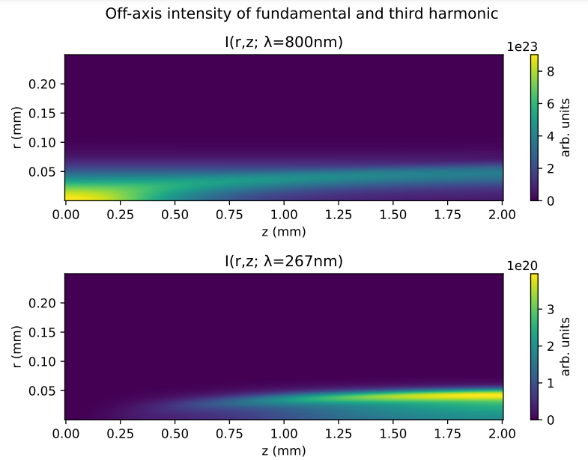
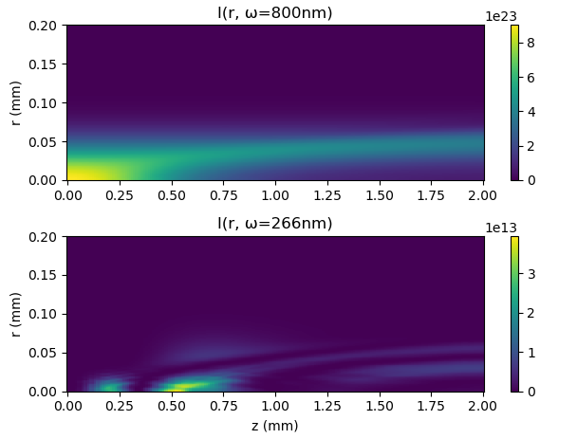
Fixed: error in intensity plots
new code

Slide 4
New features
Three new core features were added:
Option to base input pulse on measured time-intensity data
Tested with IR FROG data from Sync&Share
Option to overlay measured UV pulse for comparison
Tested with UV spectra from Sync&Share
Option to base gas density profile on measured/simulated density data
Untested due to lack of data: get COMSOL files

Slide 5
New features: notes
So far, the input beam is still modelled as a Gaussian in space
spatial profile could easily be based on measured data, too, if necessary
CEO phase of measured input beam was set to zero
replace with measured value?
Measured UV spectrum is rescaled when overlayed, so no quantitative spectral comparison is possible
Due to lack of COMSOL data, there are no runs with the improved density model yet

Slide 6
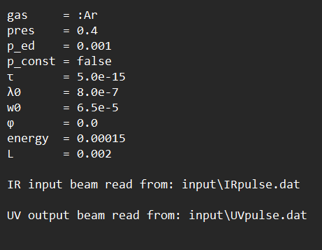
Example run
The following slides show sample output for a run with the parameter values:
Essentially standard settings with gradient approximation for pressure
Raw data from data files on Sync&Share, processed using a Python program called
“file_prepare.py” (also on GitHub)

Slide 7
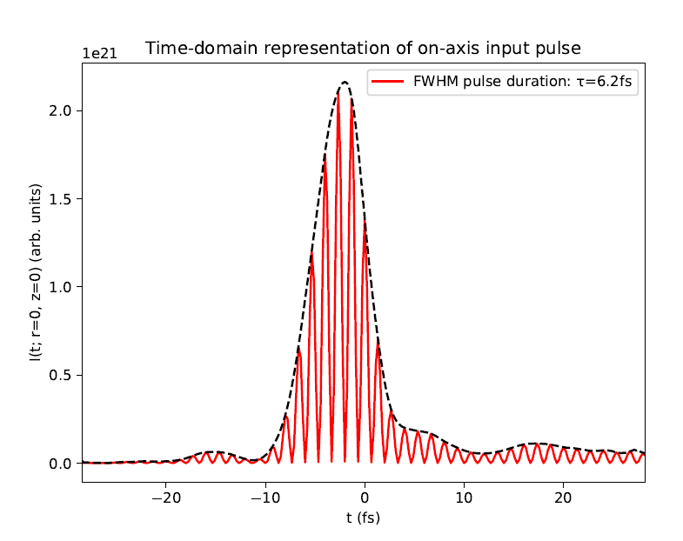
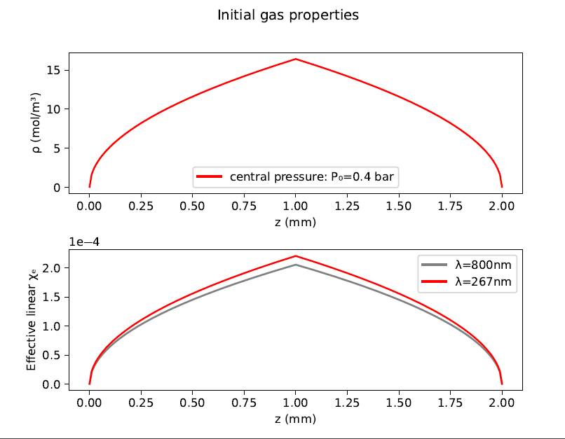
Example run

Slide 8
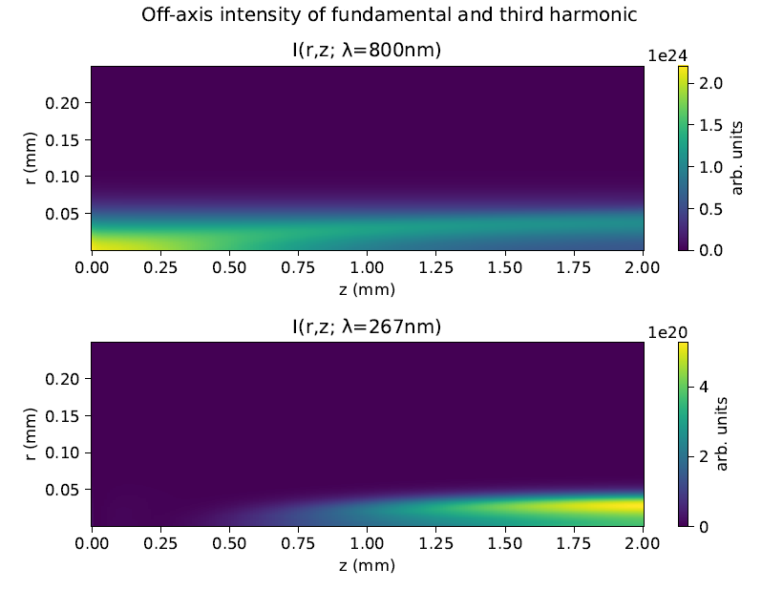
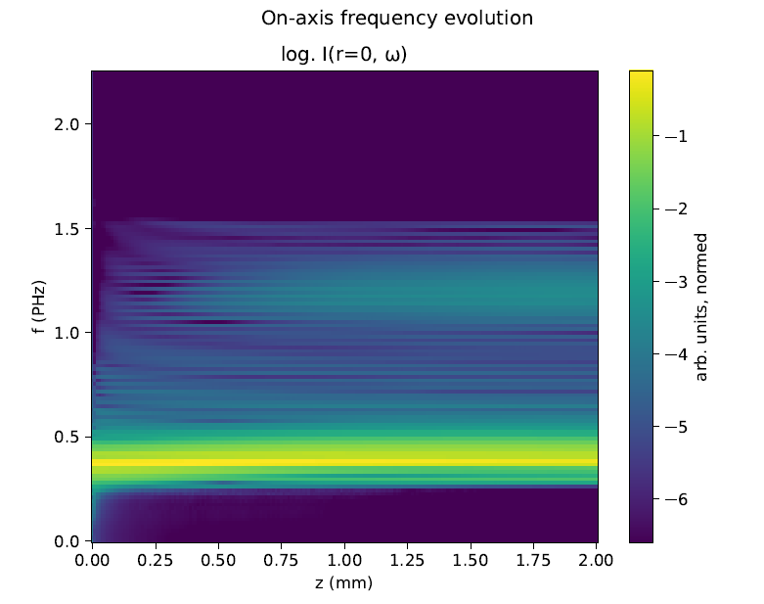
Example run

Slide 9
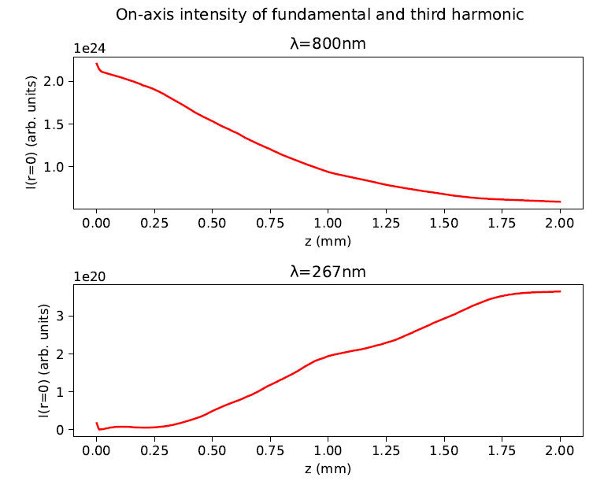
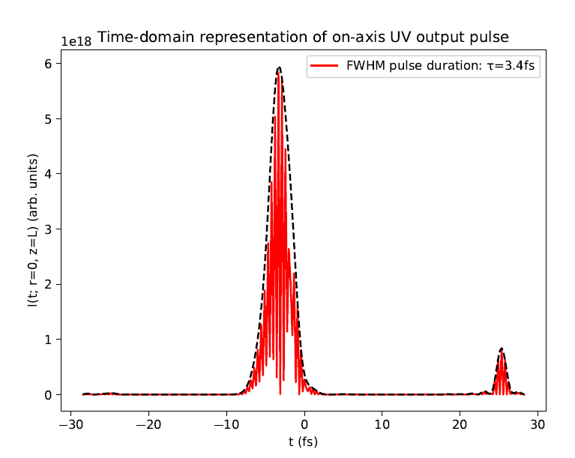
Example run

Slide 10
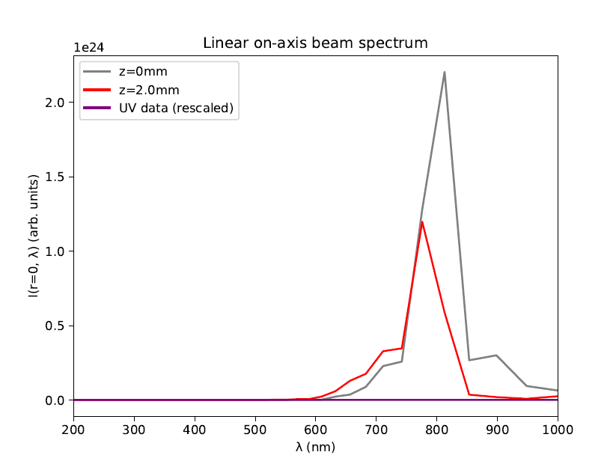
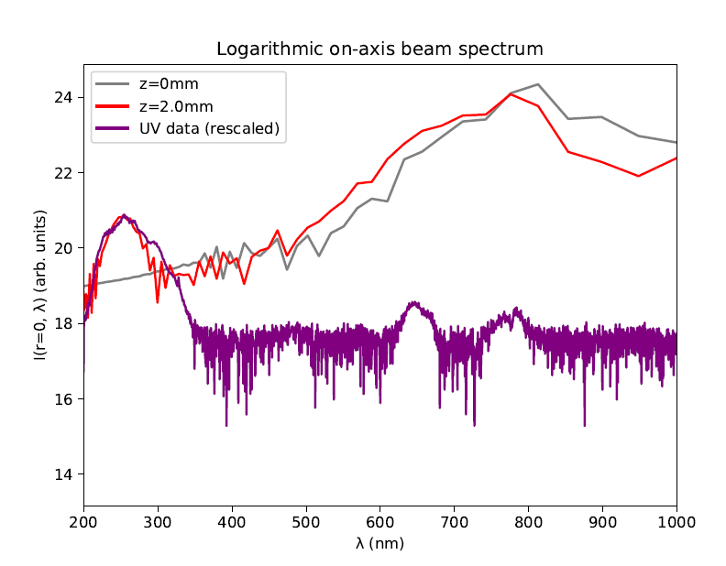
Example run

Slide 11
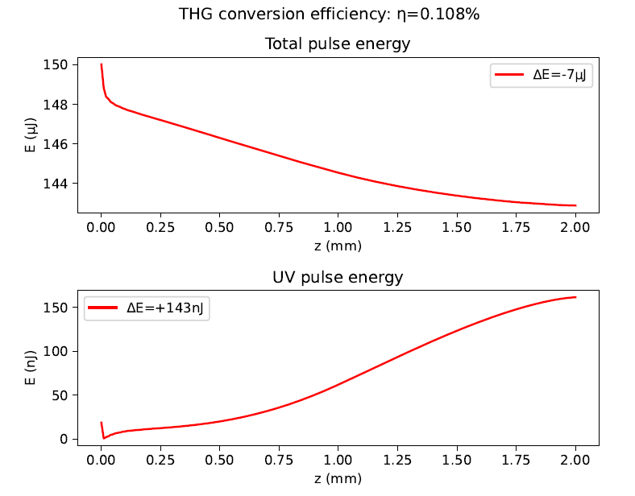
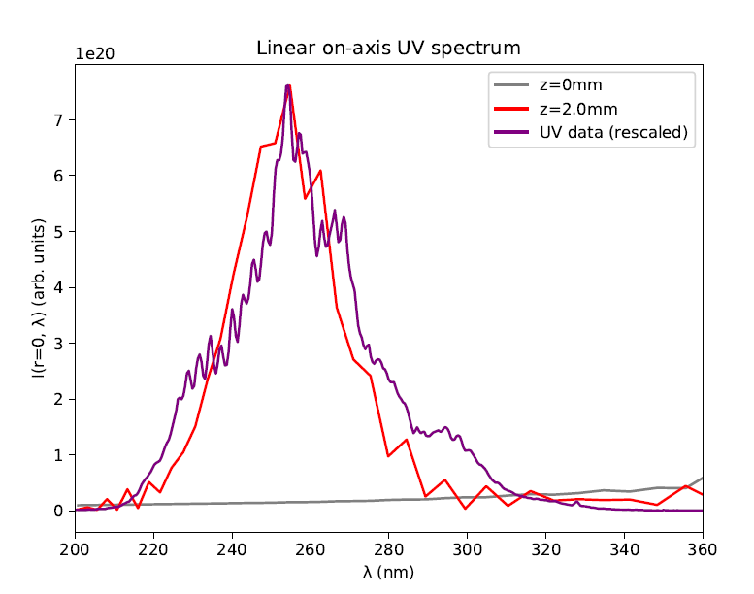
Example run
Measured pulse energy: 110nJ

Slide 12
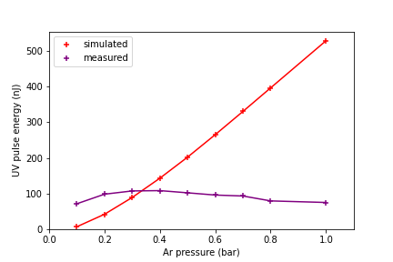
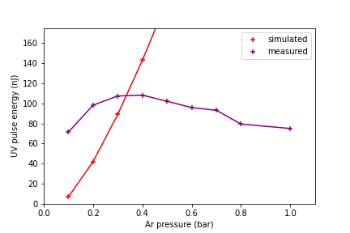
Pressure scan
Ran simulations for Argon and 150mW pulses with pressures ranging from 0.1 bar to 1.0 bar:
No saturation observed in simulations
[zoomed]

Slide 13
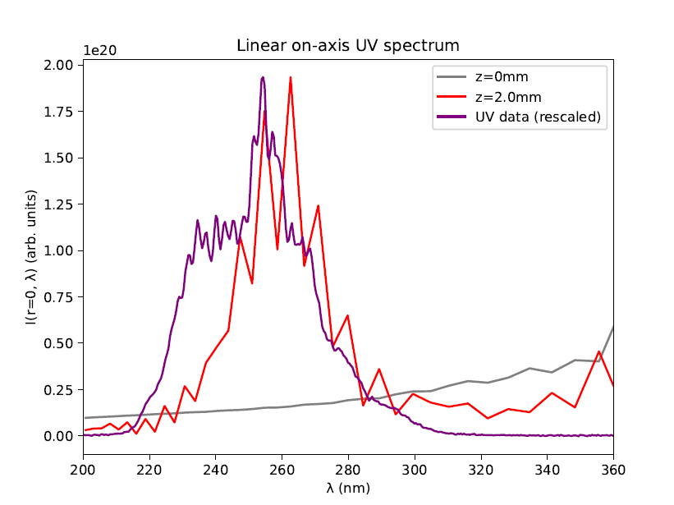
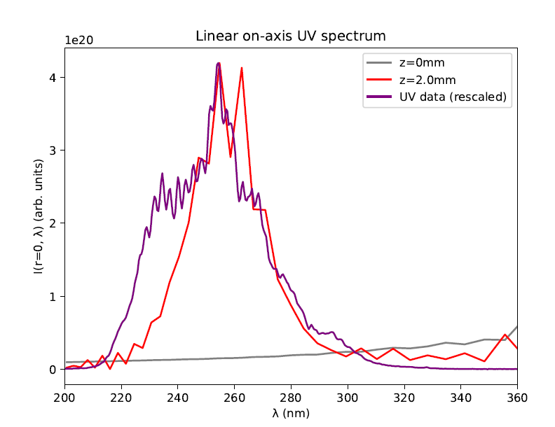
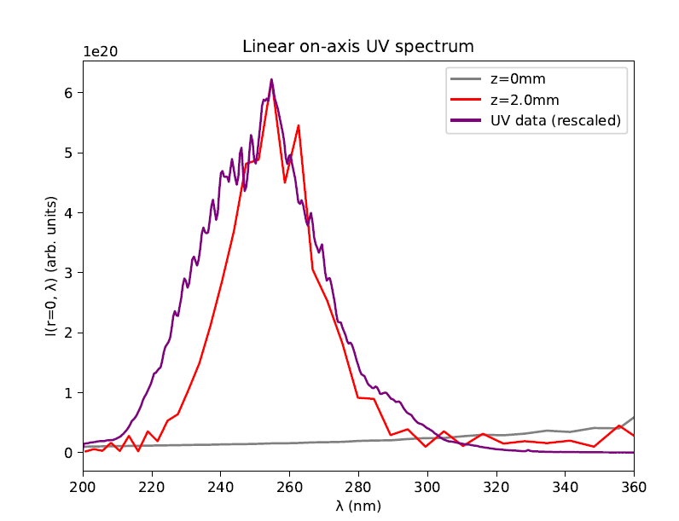
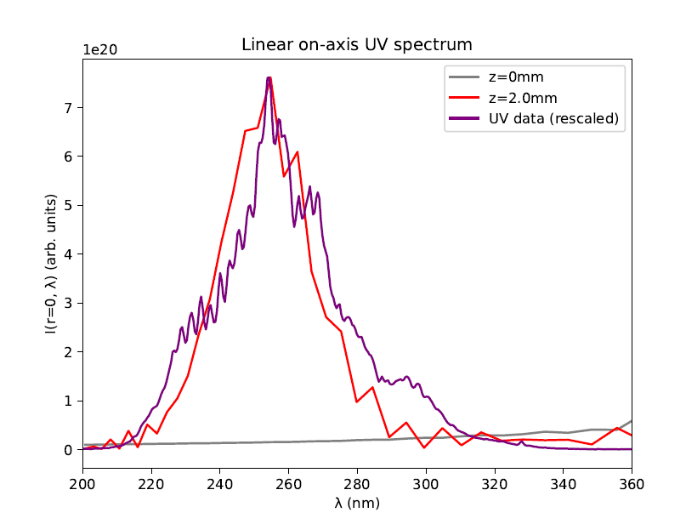
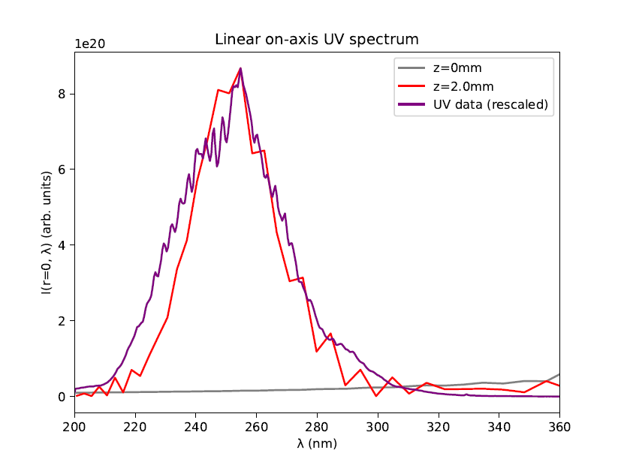
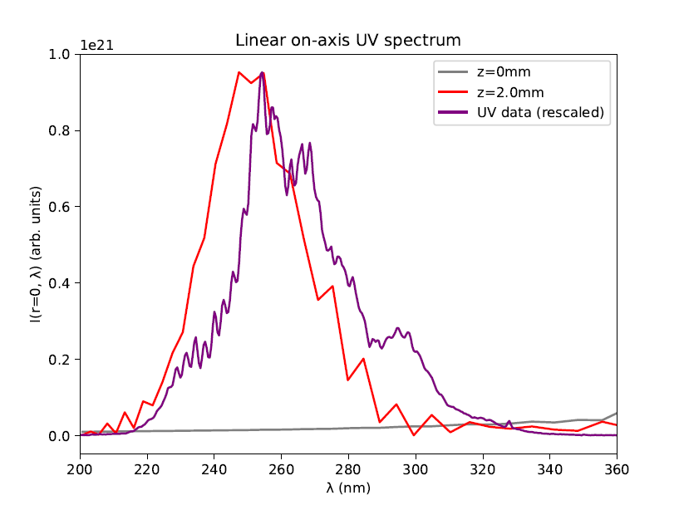
Pressure scan: spectra
Measured UV data
Simulated UV data
0.1 bar
0.2 bar
0.3 bar
0.5 bar
0.4 bar
0.6 bar

Slide 14
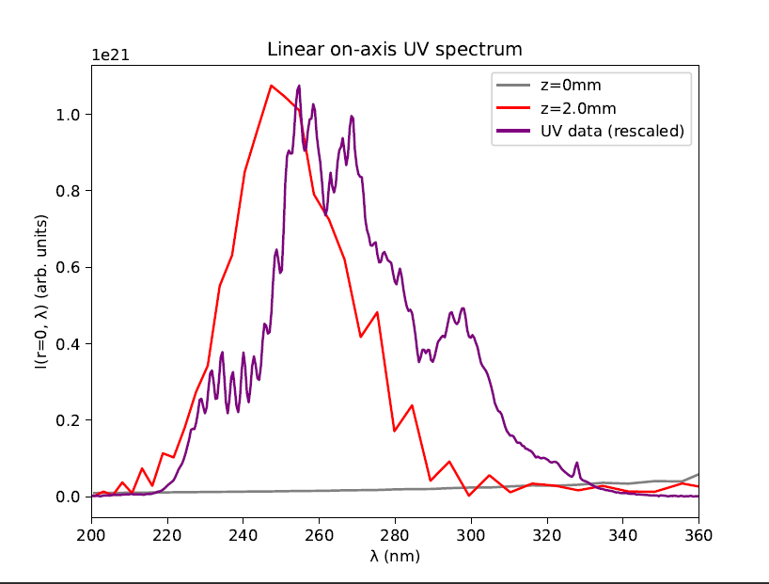
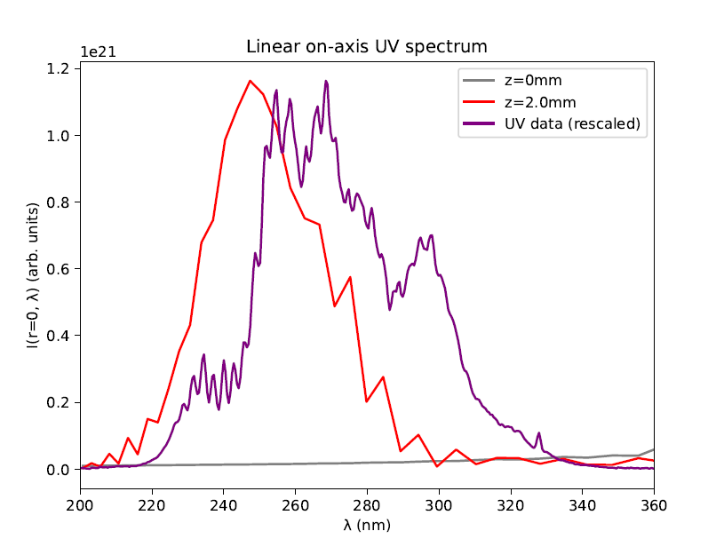
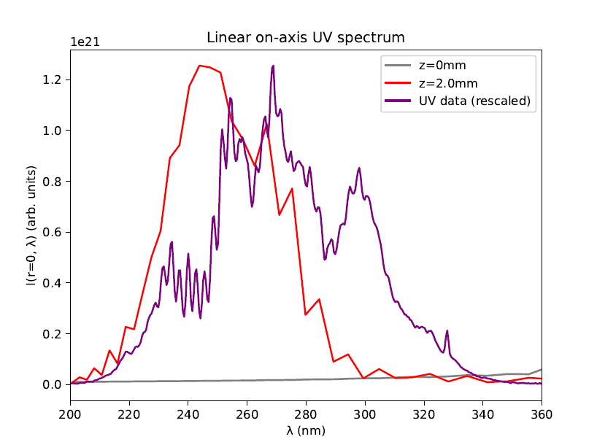
Pressure scan: spectra
Measured UV data
Simulated UV data
0.7 bar
0.8 bar
1.0 bar
Additional spectral peaks not observed in simulations

Slide 15
Conclusions
For some pressures (~0.4bar) there is fairly good agreement between the measurements and the simulations
At high and low pressures, simulations and data diverge
Possible reason: breakdown of pressure gradient model
Try using COMSOL simulations of gas density instead?!
Alternative reason: nonlinear model incomplete
???

Slide 16
Next steps?
Get COMSOL simulation data for gas density?
Set up non-Gaussian spatial profile?
Measure CEO phase?
Get more data?
Input pulses at different beam energies (75mW, 150mW, 300mW,…)
UV spectra at more beam energies and gas pressures
UV data for Neon

